Slide 1
Health record system
Query for data manipulation

Slide 2
SCHEMA’S
Details(user_id, first_name, last_name, user_age, user_gender, body_weight, height, mobile_number)
Calculated_details(user_id, first_name, last_name, user_age, user_gender, body_weight, height, bmi, bmr, calorie_per_day, protein_requirement, mobile_number)
Range(user_id, first_name, last_name, user_age, user_gender, body_weight, height, bmi, bmi_range)
Diet_name( user_id, Monday, Tuesday, Wednesday, Thursday, Friday, Saturday )
Diet_schedule( user_id, time, Monday, Tuesday, Wednesday, Thursday, Friday, Saturday)
Workout_plan( user_id, chest, back, bicep, tricep, shoulder, legs)

Slide 3
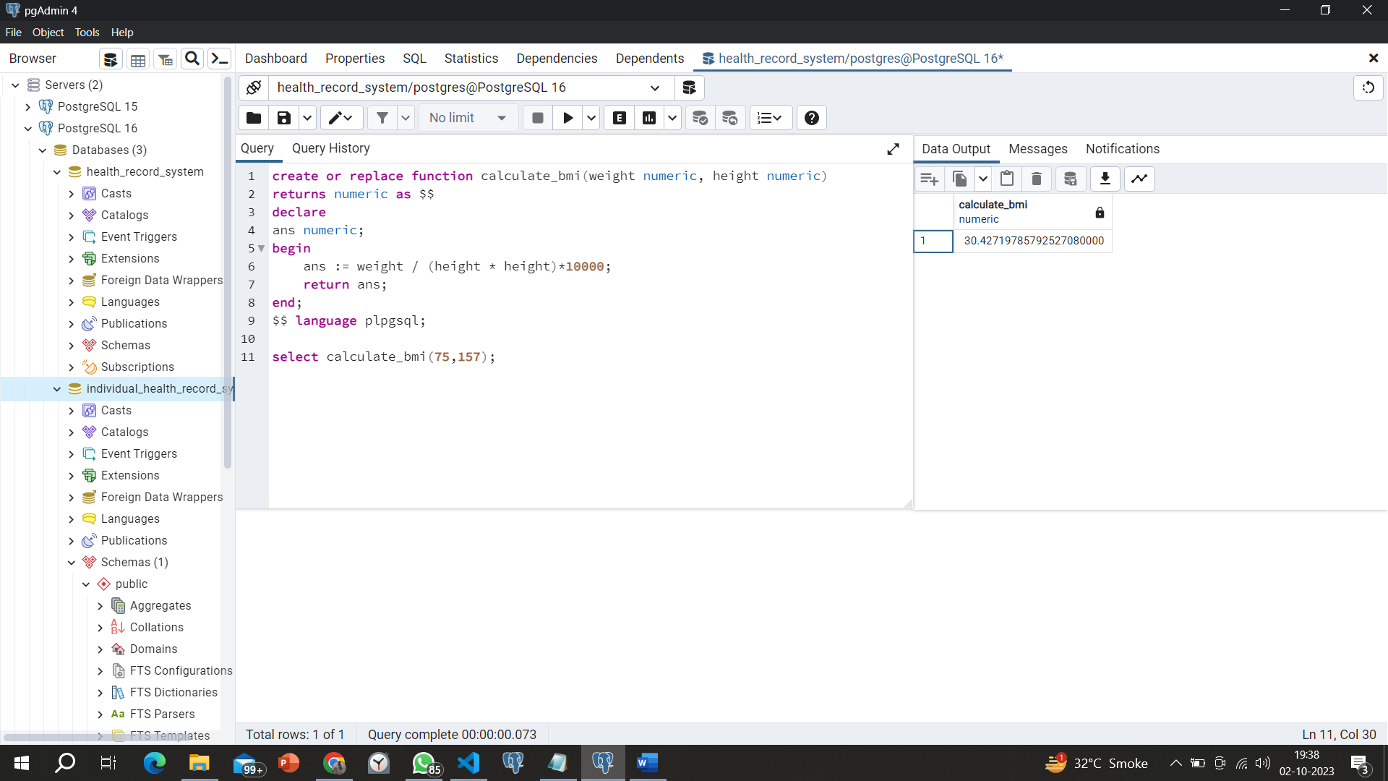
1. Create a function to calculate bmi.

Slide 4
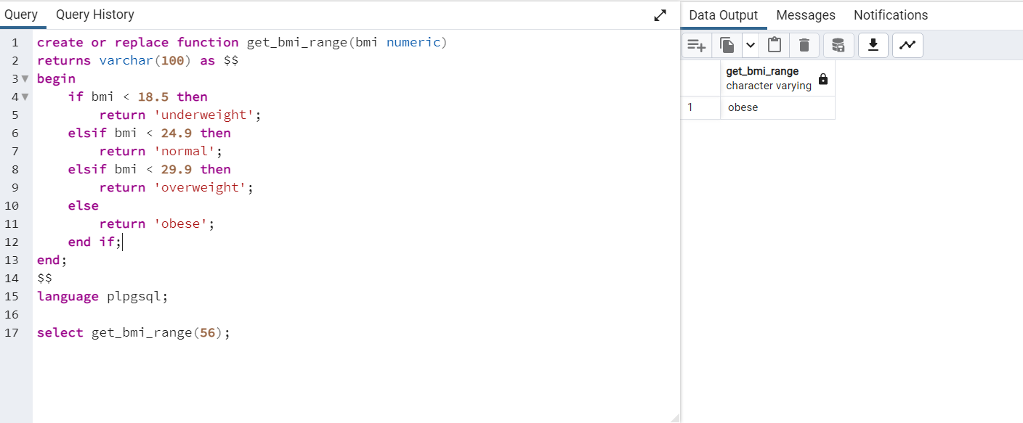
2. Create function to get bmi range

Slide 5
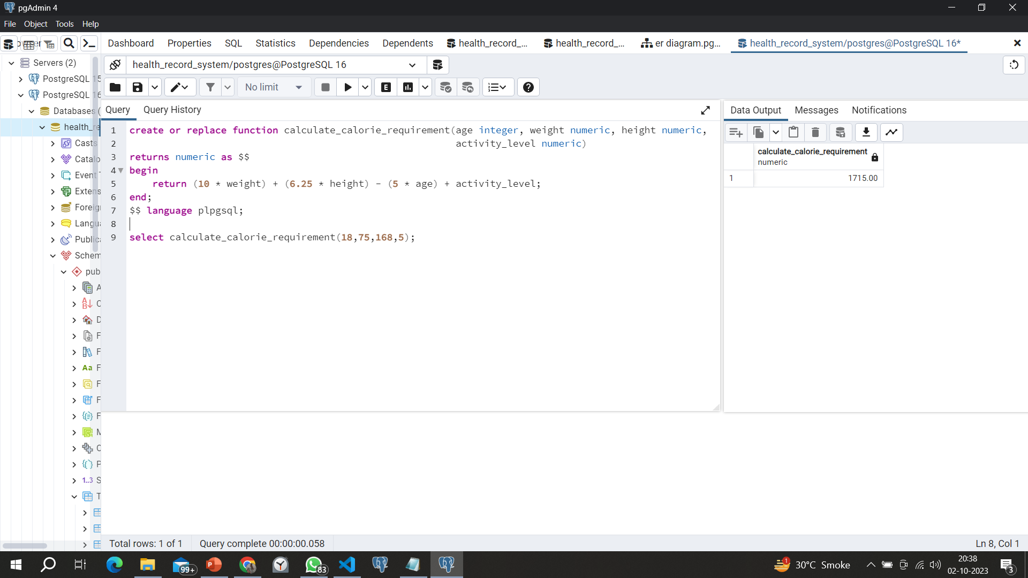
3. Create function to calculate protein requirement

Slide 6
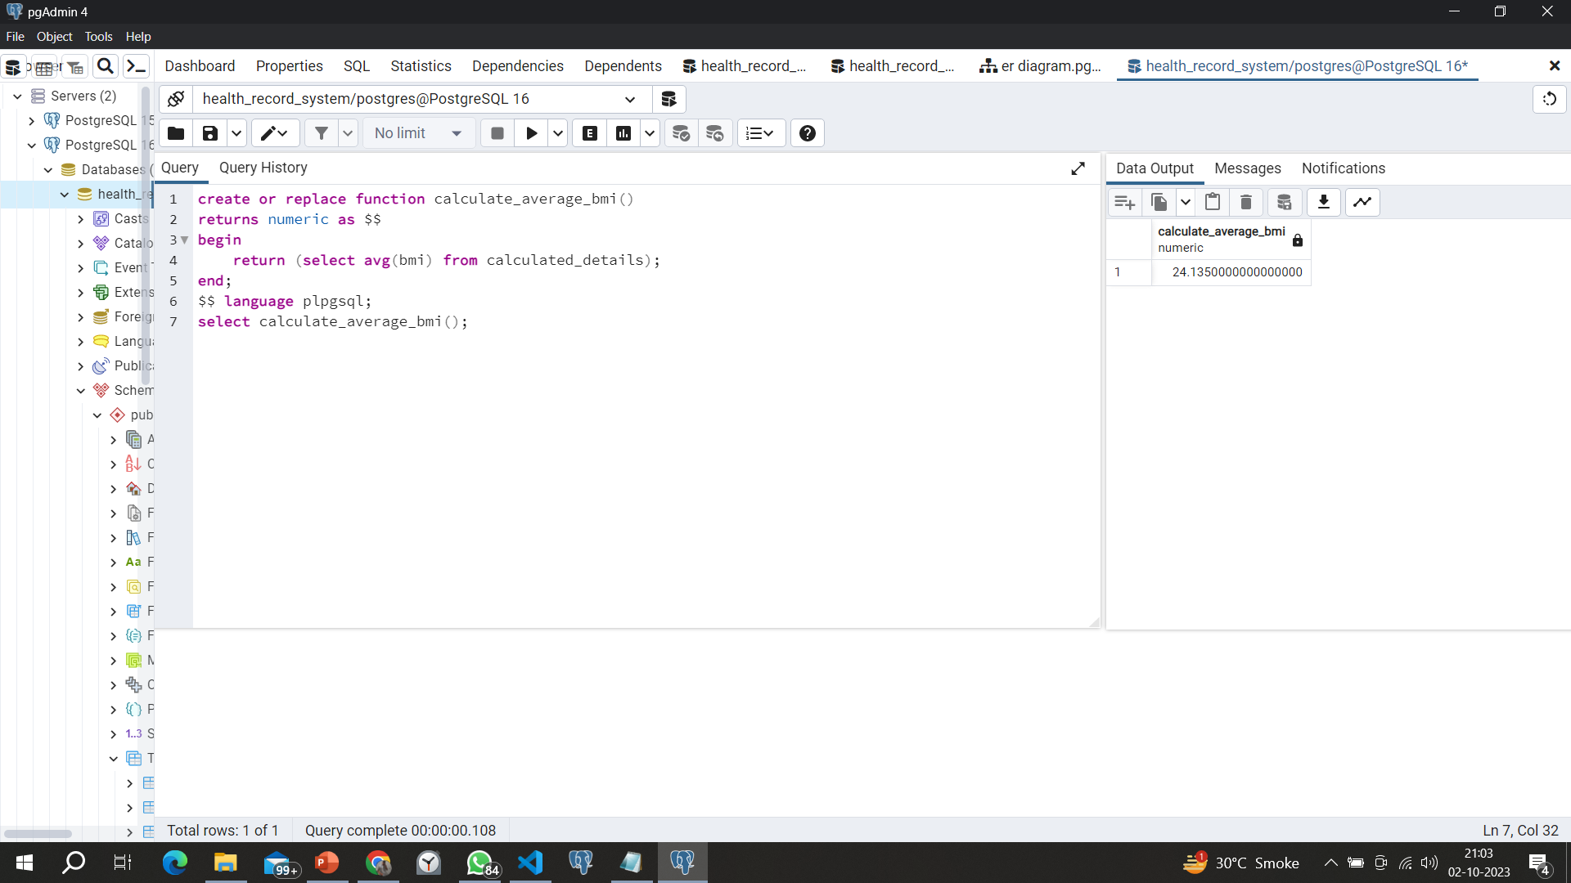
4. Create aggregate function to calculate average bmi.

Slide 7
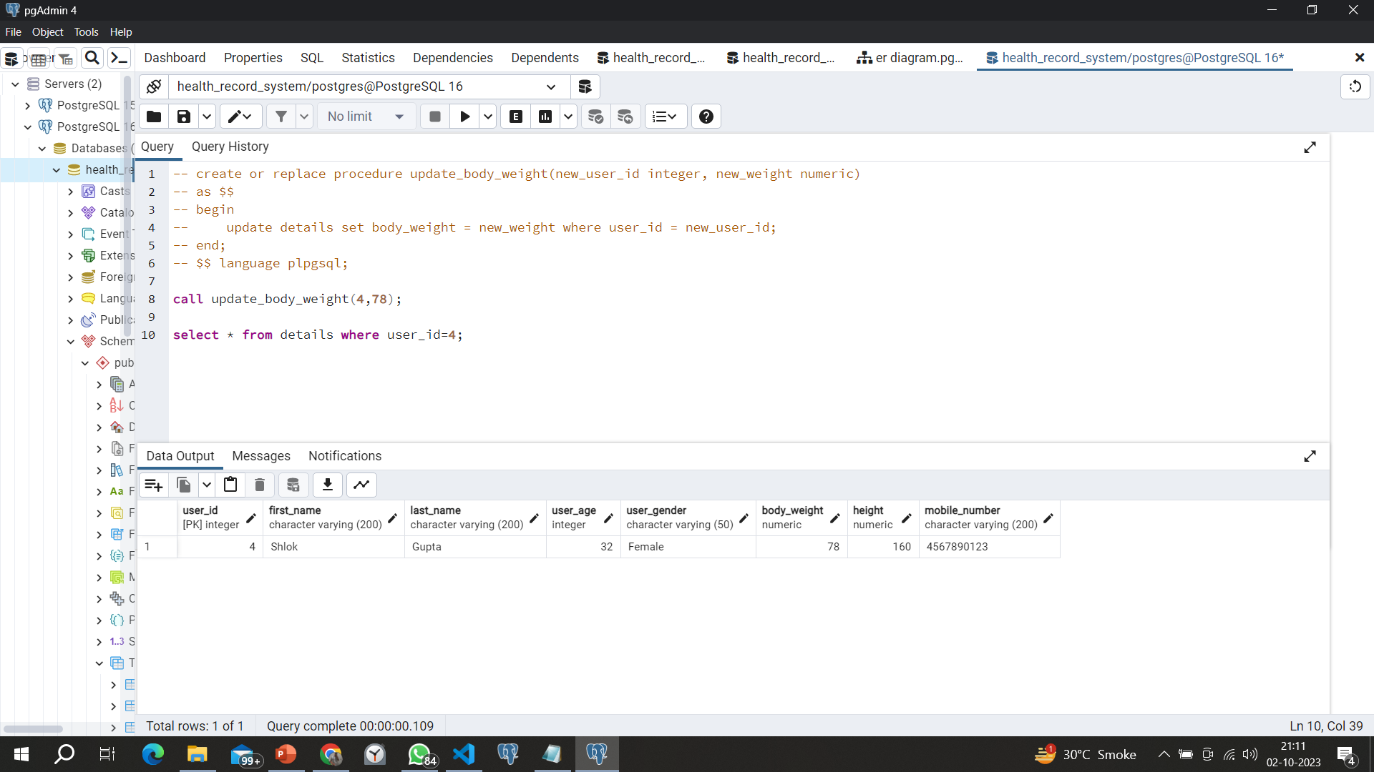
5.Create procedure to update body weight

Slide 8
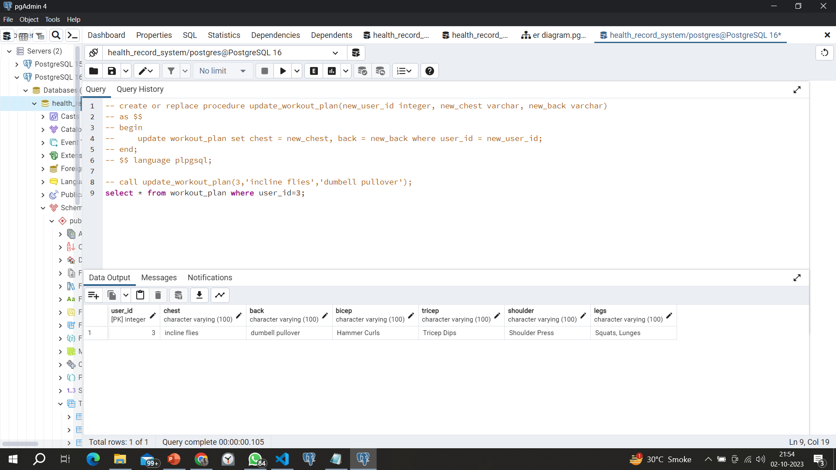
6. Create procedure to update workout plan

Slide 9
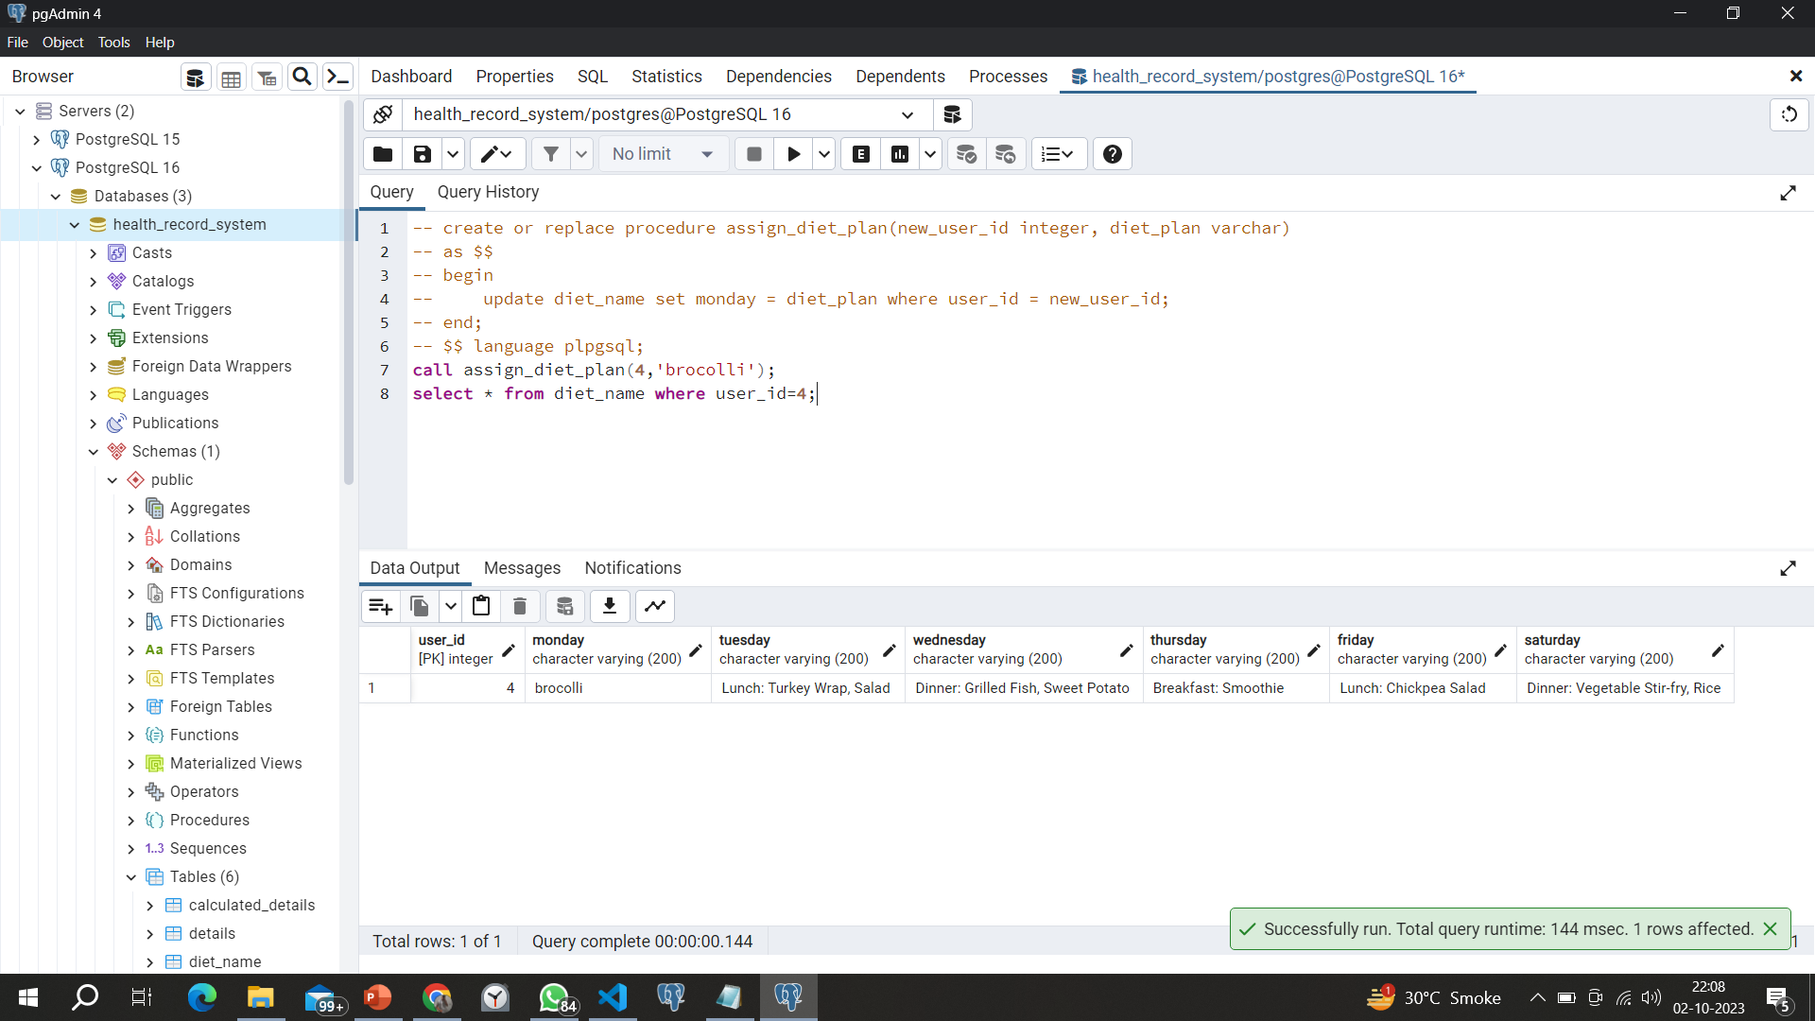
7. Create procedure to update diet plan

Slide 10
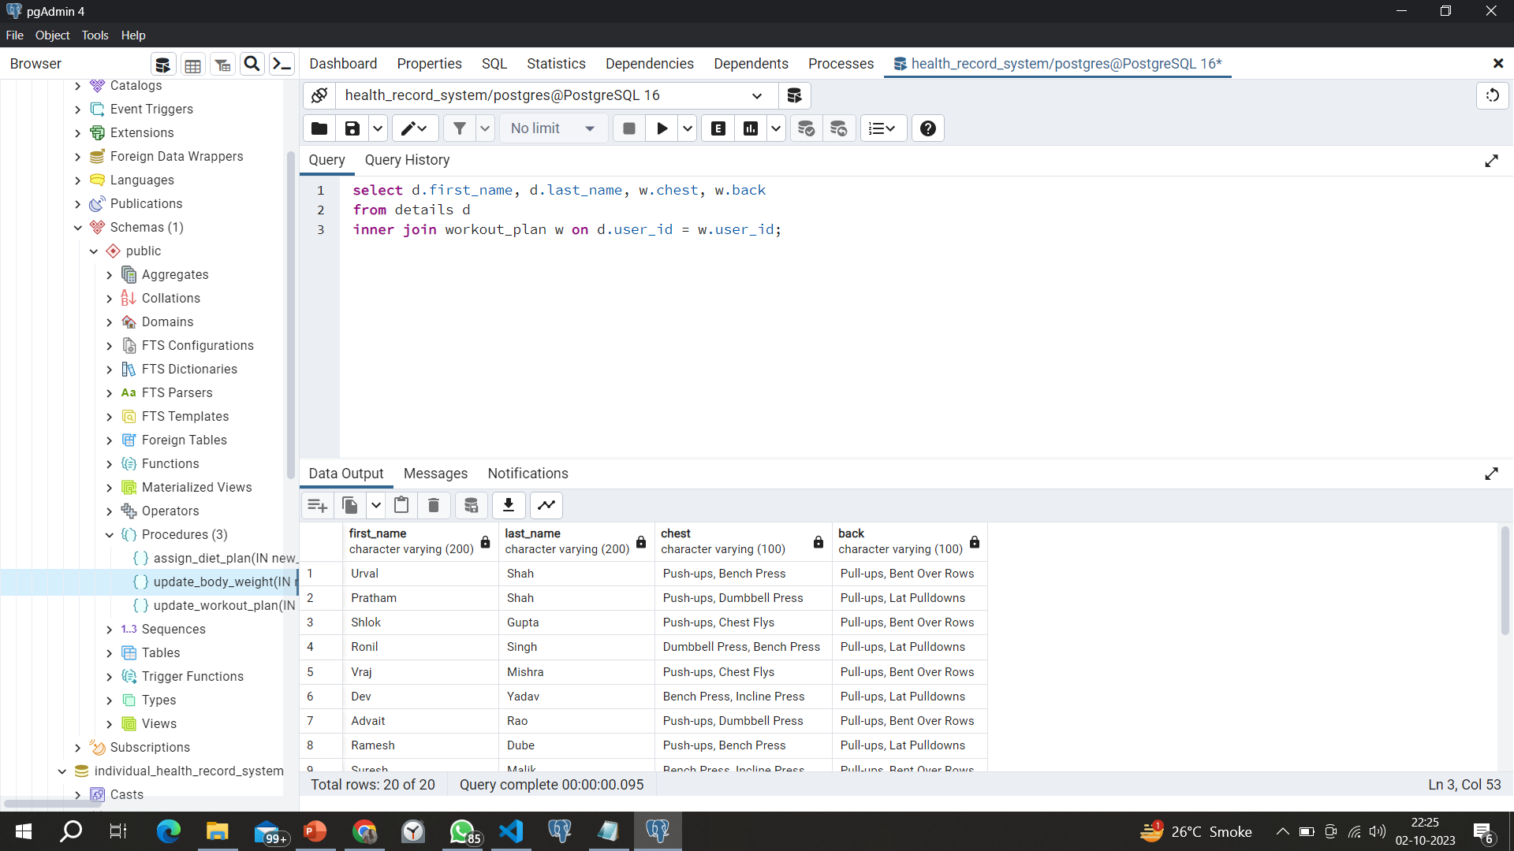
8. Subquery to retrieve users and their workout plan

Slide 11
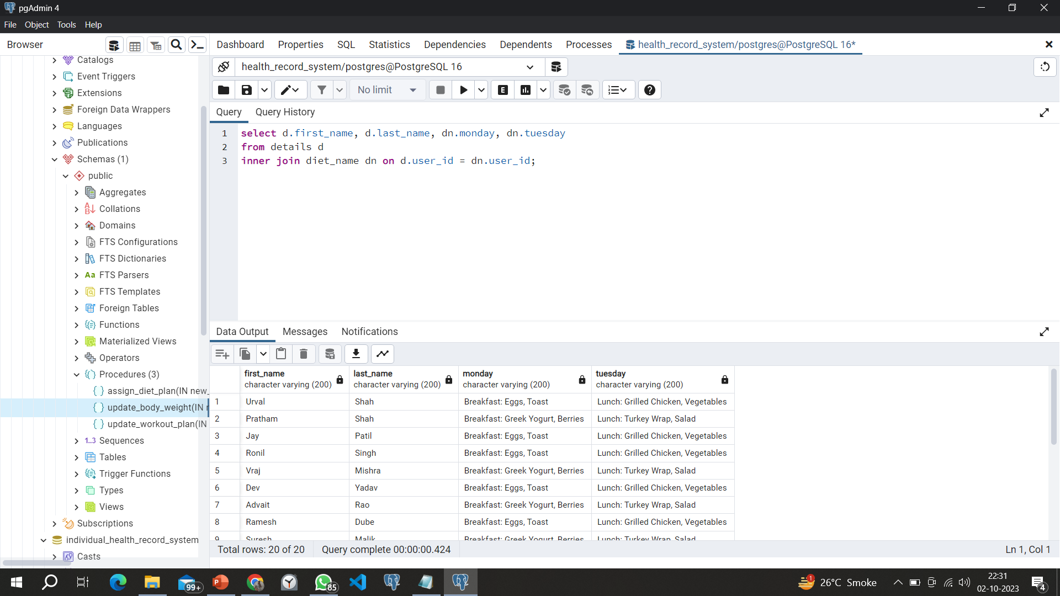
9. Subquery to retrieve users and their assigned diet plan

Slide 12
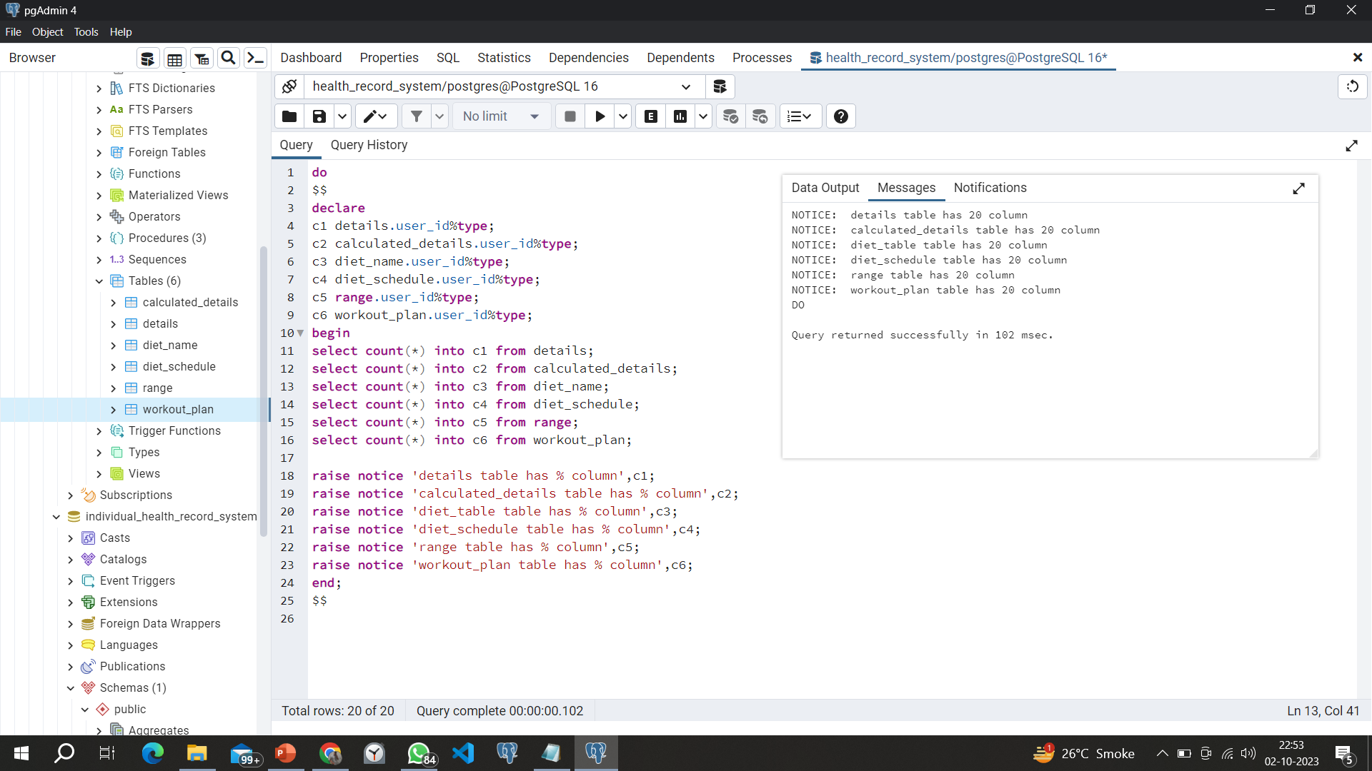
10. Count number of user by cursor

